Slide 1
Clustering algorithms

Slide 2
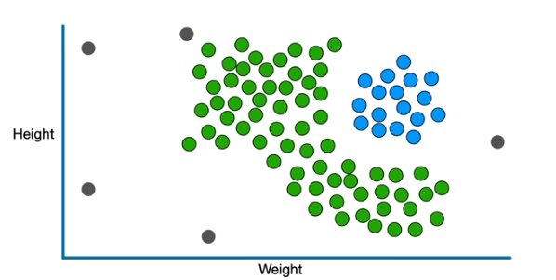
DBSCAN Algorithm
density-based clustering algorithm that groups data points that are closely packed together
marks outliers as noise based on their density
Unlike K-Means or hierarchical clustering which assumes clusters are compact and spherical, DBSCAN perform well in handling real-world data irregularities

Slide 3
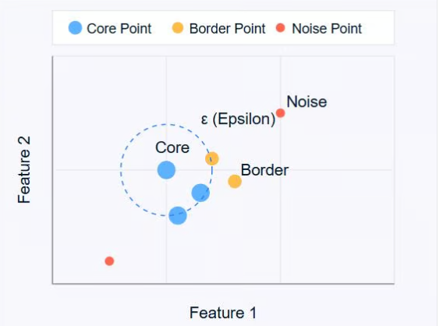
Key concepts
Core Points: These are points that have at least a minimum number of other points within a specified distance (ε or epsilon).
Border Points: These are points that are within the ε distance of a core point but don't have Minimum number of points neighbors themselves.
Noise Points: These are points that are neither core points nor border points. They're not close enough to any cluster to be included.
dbscan = DBSCAN(eps=0.2, min_samples=5)
labels = dbscan.fit_predict(X)

Slide 4
HDBSCAN Algorithm
Hierarchical Density-Based Spatial Clustering of Applications with Noise (HDBSCAN) is a clustering algorithm that extends the DBSCAN algorithm by converting it to a hierarchical clustering algorithm.
It is especially useful in situations where the dataset might not be perfectly clean, and there's inherent noise.
# Apply HDBSCAN
clusterer = hdbscan.HDBSCAN(min_cluster_size=20, min_samples=1) labels = clusterer.fit_predict(X)

Slide 5
How does HDBSCAN work?
HDBSAN examines the density of the data points in the dataset.
It starts by calculating a density-based clustering hierarchy, which creates clusters from densely connected data points.
This hierarchical structure enables the recognition of clusters of various shapes and sizes.
eliminates the noise by constantly adjusting the minimum cluster size parameter and adding a minimum spanning tree.

Slide 6
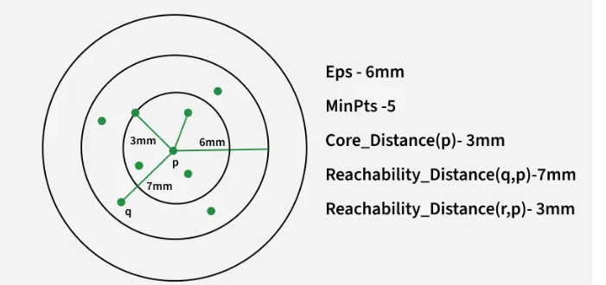
OPTICS Algorithm
OPTICS (Ordering Points To Identify the Clustering Structure), which stands out for its ability to identify clusters of varying densities.
OPTICS does not directly assign clusters but instead creates a reachability plot which visually represents clusters.
Core Distance: The minimum
distance needed for a point to
be classified as a core point.
Reachability Distance: It is a
measure of how difficult it is to
reach from one point to another.

Slide 7
Working of OPTICS
The algorithm selects a starting point and checks if it has at least MinPts neighbors within Eps.
If the point meets the density requirement it is marked as a core point and nearby points are then analyzed.
Reachability distance is computed for each neighboring point.
Points are then processed in order of their reachability distance hence forming a reachability plot.
Clusters appear as valleys i.e low reachability distances and noise appears as peaks i.e high reachability distances.

Slide 8
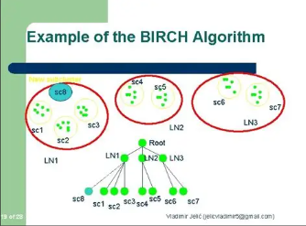
BRICH Algorithm
BIRCH (Balanced Iterative Reducing and Clustering hierarchies) is a hierarchical clustering algorithm that is designed to handle large datasets efficiently.
The algorithm builds a treelike structure of clusters by recursively partitioning the data into subclusters until a stopping criterion is met.

Slide 9
Important terms
Clustering Feature (CF) and
CF Tree Construction
Clustering Feature - Each cluster is represented by a compact summary called a CF, which includes:
N: Number of data points in the cluster.
LS: Linear sum of the data points.
SS: Squared sum of the data points.
These values help calculate the centroid, radius, and diameter of clusters efficiently.
CF Tree Construction - The algorithm builds a CF Tree by recursively partitioning data into subclusters.
Each node in the tree represents a cluster, and leaf nodes store compact summaries of subclusters
birch = Birch(n_clusters=3)
birch.fit(data)

Slide 10
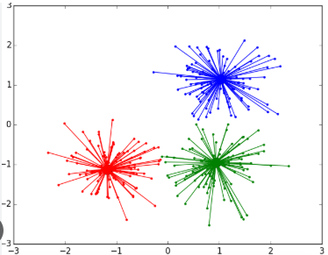
Affinity propagation
Affinity Propagation is a clustering algorithm that identifies exemplars (representative data points) and groups all other data points with their closest exemplars.
Unlike methods such as K-Means, Affinity
Propagation determines cluster centres
by iteratively exchanging “messages”
between data points to identify the most
suitable exemplars.
The algorithm does not require prior labels, it clusters
purely based on similarity.
model = AffinityPropagation(preference=preference, random_state=42)
model.fit(X_std)

Slide 11
Working of Affinity Propagation
Calculate
1. Similarity Computation
2. Responsibility Update
3. Availability Update
4. Iterative Updates and Convergence
Key Parameters Influencing Clustering
Preference
Controls the number of exemplars (cluster centers).
2. Damping Factor
Helps stabilize the algorithm by limiting the update size between iterations.

Slide 12
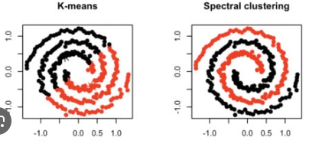
Spectral Clustering
It groups data points by using the eigenvectors of a similarity matrix to transform the data into a lower-dimensional space
It works well for cluster with non-convex shapes that are difficult for algorithms like K-means to detect directly.

Slide 13
Steps performed for spectral Clustering
Building the Similarity Graph Of The Data
builds the Similarity Graph in the form of an adjacency matrix
adjacency matrix can be built in the following manners:
Epsilon-neighbourhood Graph
K-Nearest Neighbours
Projecting the data onto a lower Dimensional Space
# find eigenvalues and eigenvectors
vals, vecs = np.linalg.eig(A)
spectral_model_rbf = SpectralClustering(n_clusters = 2, affinity ='rbf')
labels_rbf = spectral_model_rbf.fit_predict(X_principal)

